Slide 1
HOMEWORK-Predicate Logic
Bogdan Teodora- Group 911

Slide 2
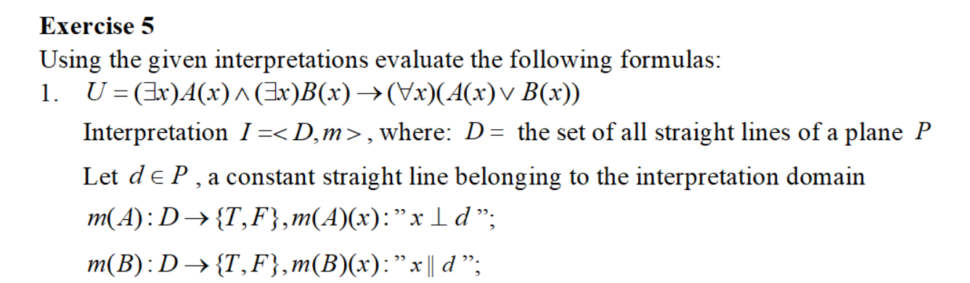
Exercise 5.1 – Predicate Logic

Slide 3
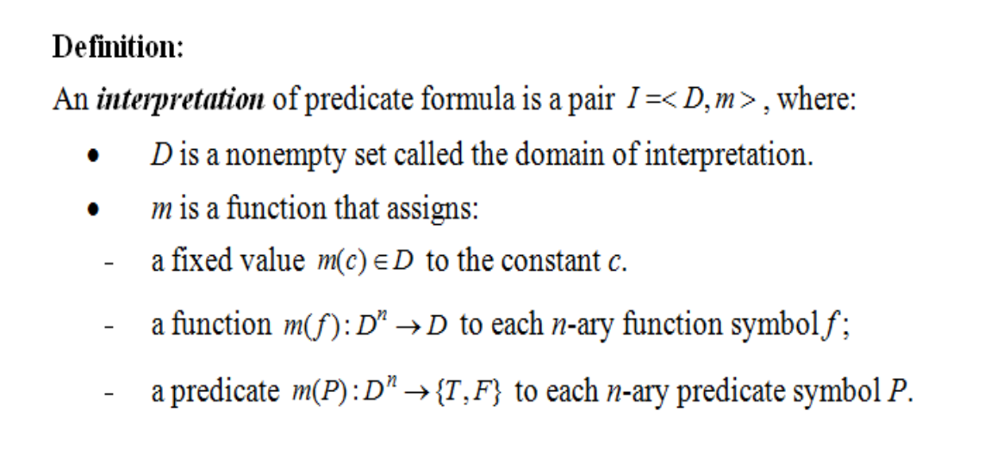
Theoretical results

Slide 4
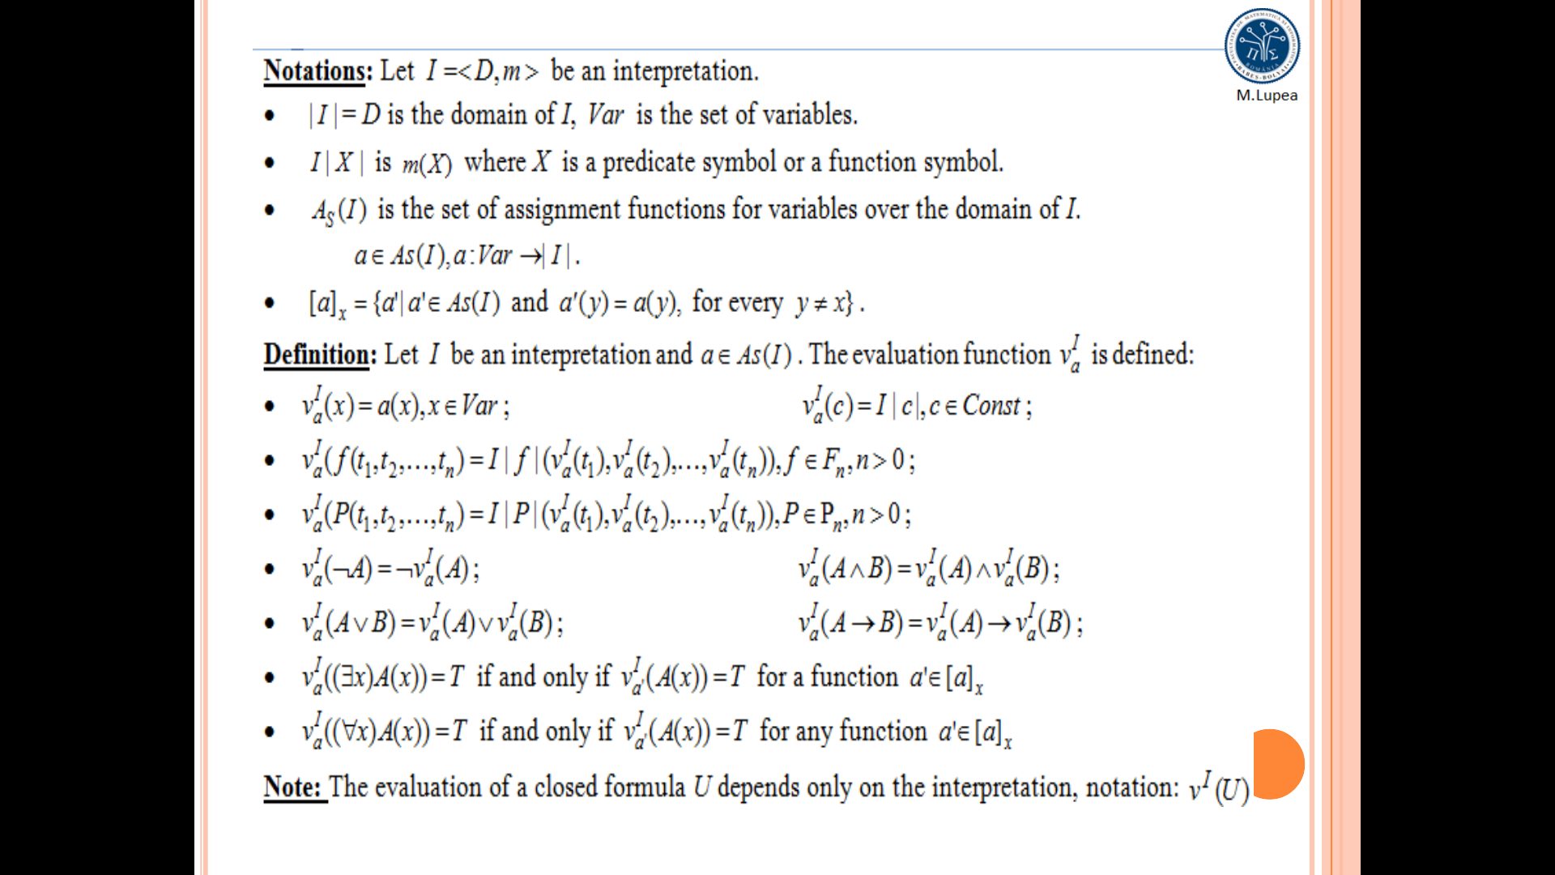

Slide 6
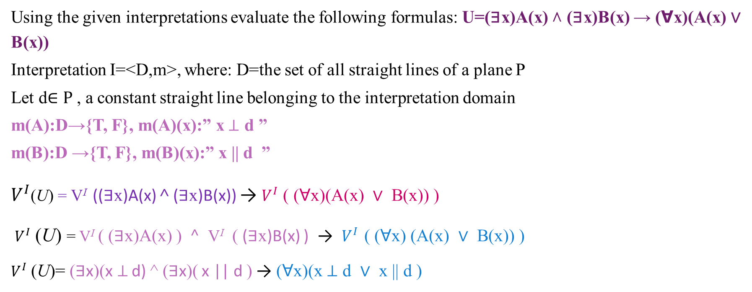
Exercise 5.1
Using the given interpretations evaluate the following formulas: U=(∃x)A(x) ˄ (∃x)B(x) → (ꓯx)(A(x) ∨ B(x))
Interpretation I=<D,m>, where: D=the set of all straight lines of a plane P
Let d$∈P$, a constant straight line belonging to the interpretation domain
m(A):D→{T, F}, m(A)(x):” x$⊥$ d ”
m(B):D →{T, F}, m(B)(x):” x || d ”
$V^{I}$(U) = V^{I} ((∃x)A(x) ˄ (∃x)B(x)) → $V^{I}$ ( (ꓯx)(A(x) ∨ B(x)) )
$V^{I}$ (U) = V^{I} ( (∃x)A(x) ) $^$ V^{I} ( (∃x)B(x) ) → $V^{I}$ ( (ꓯx) (A(x) ∨ B(x)) )
$V^{I}$ (U)= (∃x)(x$⊥$ d) ^ (∃x)( x || d ) → (ꓯx)(x$⊥$ d ∨ x || d )

Slide 7
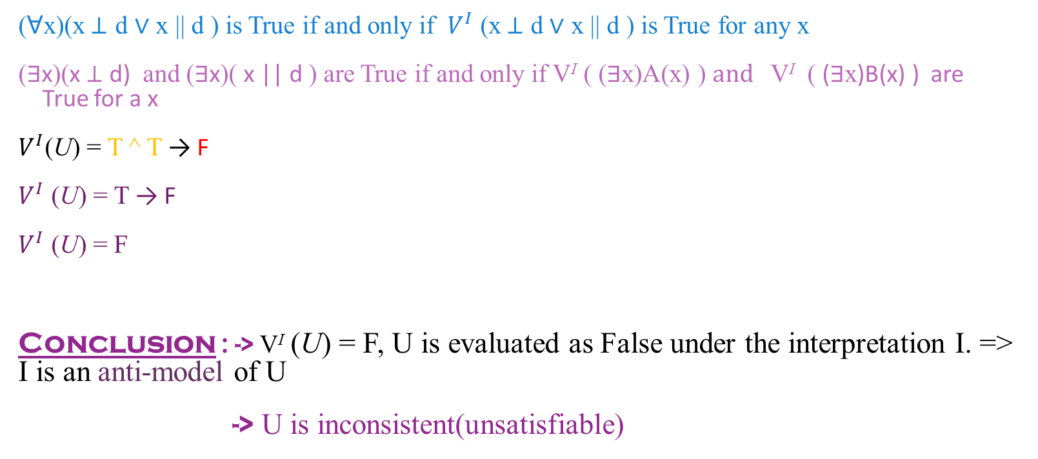
(ꓯx)(x$⊥$ d ∨ x || d ) is True if and only if $V^{I}$ (x$⊥$ d ∨ x || d ) is True for any x
(∃x)(x$⊥$ d) and (∃x)( x || d ) are True if and only if V^{I} ( (∃x)A(x) ) $and$ V^{I} ( (∃x)B(x) ) are True for a x
$V^{I}$(U) = T ^ T → F
$V^{I}$ (U) = T → F
$V^{I}$ (U) = F
Conclusion : -> V^{I} (U) = F, U is evaluated as False under the interpretation I. => I is an anti-model of U
-> U is inconsistent(unsatisfiable)

